Slide 1


LOCAL JOBS ANALYSIS
Enghy, Jeff, Kelvin, Frondia
Notes:
Good evening everyone, we’re group 5 and we will be presenting you with a local jobs analysis tonight. This subject has been presented a couple times already so please bear with us. I’m here with Enghy, Jeff, and Frondia.

Slide 2
What’s NEXT after Xccelerate?
Notes:
1 min (Kelvin)
Hong Kong is considered a well developed city from finance to real estate to technology. But Hong Kong has been a bit behind other countries when it comes to developing the data science field. In recent years, there has been a growing demand for data scientist and data analyst in Hong Kong, not just in tech companies but in start-ups and traditional industries like supply chain, real estate, finance, and many more. I’m sure most of you are aware of this which is why you are here today. So what we want to present to you today is. What's NEXT? What’s NEXT after Xccelerate? Knowing what we will learn from this bootcamp, how does the job market look like taking into account the current COVID 19 situation. Dont worry, It will only get better from here.

Slide 3

GOAL OF PROJECT/BUSINESS VALUES
Identify potential jobs for Xccelerate graduates
Determine key skills to get hired as a “data” related position
Understand which Industry we will likely end up in
Explore specific locations hiring “data” jobs in Hong Kong
Share some fun facts within different data titles
Notes:
1 min (Kelvin)
So the goal of the project is to help us understand what the job market is like. To determine the key skills necessary to get hired as a data analyst/data scientist these days. Understand what industry is currently hiring people with our skillset. Explore the different locations that we will most likely end up working in and finally we will share some fun facts with you guys.

Slide 4


DATA COLLECTION
Key search words = data
Sample size from each websites:
Indeed: 605 job posts
JobsDB: 2042 job posts
web scraping (beautiful soup, Selenium)
libraries used (pandas, regular expression)
Notes:
1 min (Kelvin)
Data Collection:
We webscraped our data from two different sources, Jobsdb and Indeed. API’s were not available for either of these sites so that wasn’t an option. We scraped all job posts that had the key word “Data” in it and we captured around 11k rows of information which was a lot. From there we did some data processing which I will talk about in a bit but we ended up with 605 Job posts from Indeed and 2042 job posts from JobsDB. For Webscraping we used Beautiful Soup and selenium and for data cleaning and plotting we used pandas, regular expression and seaborn.
One point i want to bring up is, when we collected the data, we noticed that the Salary section was either blank or the range was ridiculously high that it didn’t make any sense. For example: we saw a company hiring a data analyst and the salary range was 20k to 90k for that specific job post. Because of this we decided to omit this column.

Slide 5
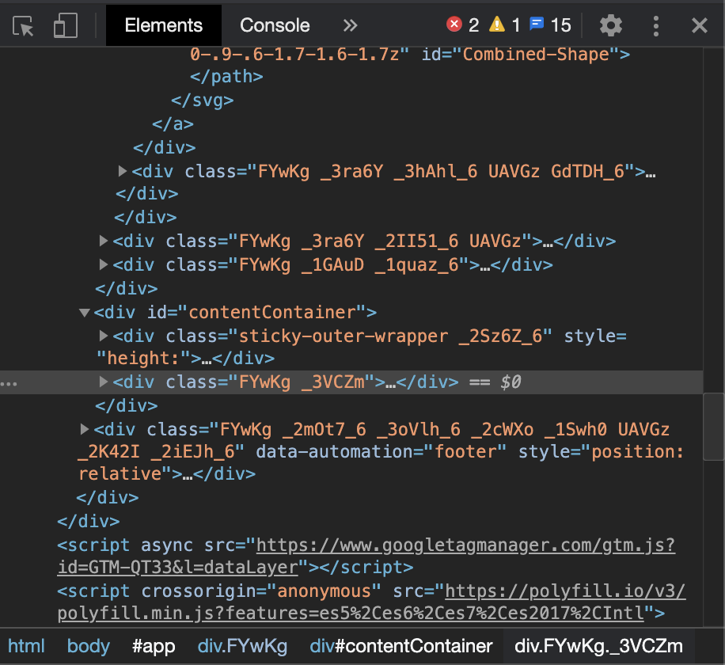
DATA PROCESSING
Merged two datasets
Removed Duplicates
Extracted information to desired columns
Generated new columns
Count of Skills
Count of Types of Benefits
Amended Types
Notes:
1-2 min (Kelvin)
After collecting the data, we merged the two datasets together. We removed any duplicates that were present. A lot of the information were piled up together so we extracted the information into desired columns using pandas and regex functions. We generated new columns counting the number of skills in each job post and counting the benefits that it offers. Finally we made sure that the data had correct types and amended as we saw fit.

Slide 6
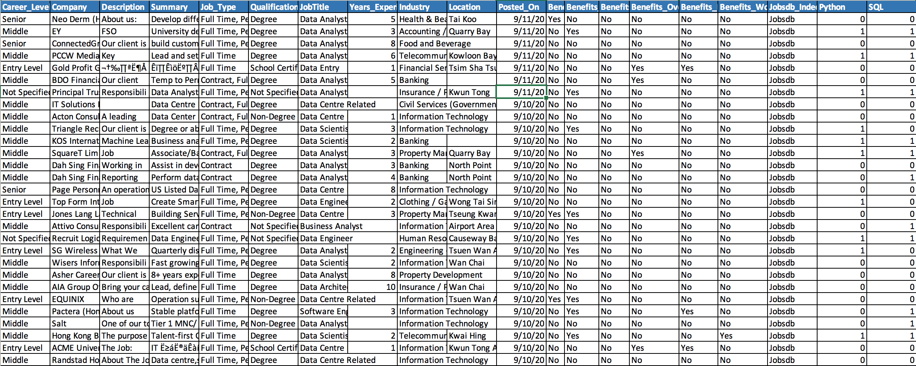
Notes:
This is how our data looks in the end. Ill pass it over to frondia to discuss the analysis portion of our project.

Slide 7
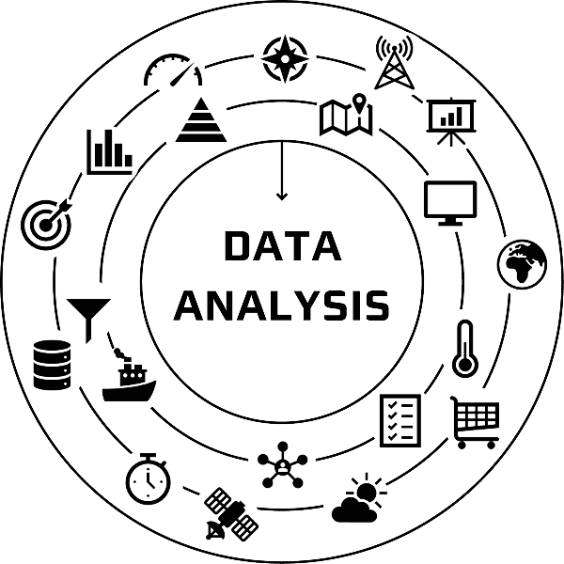
INDUSTRY
LOCATION
JOB MARKET
SKILLS
Notes:
4-6min (8 slides in total) (Frondia)
-After we organized and analyzed our data, we split our findings into four main parts: Industry - Industry, Job Market, Location, and skills. We also did some online research to see if our findings and analysis are consistent with the Hong Kong job trend. And now I start from Industry.

Slide 8
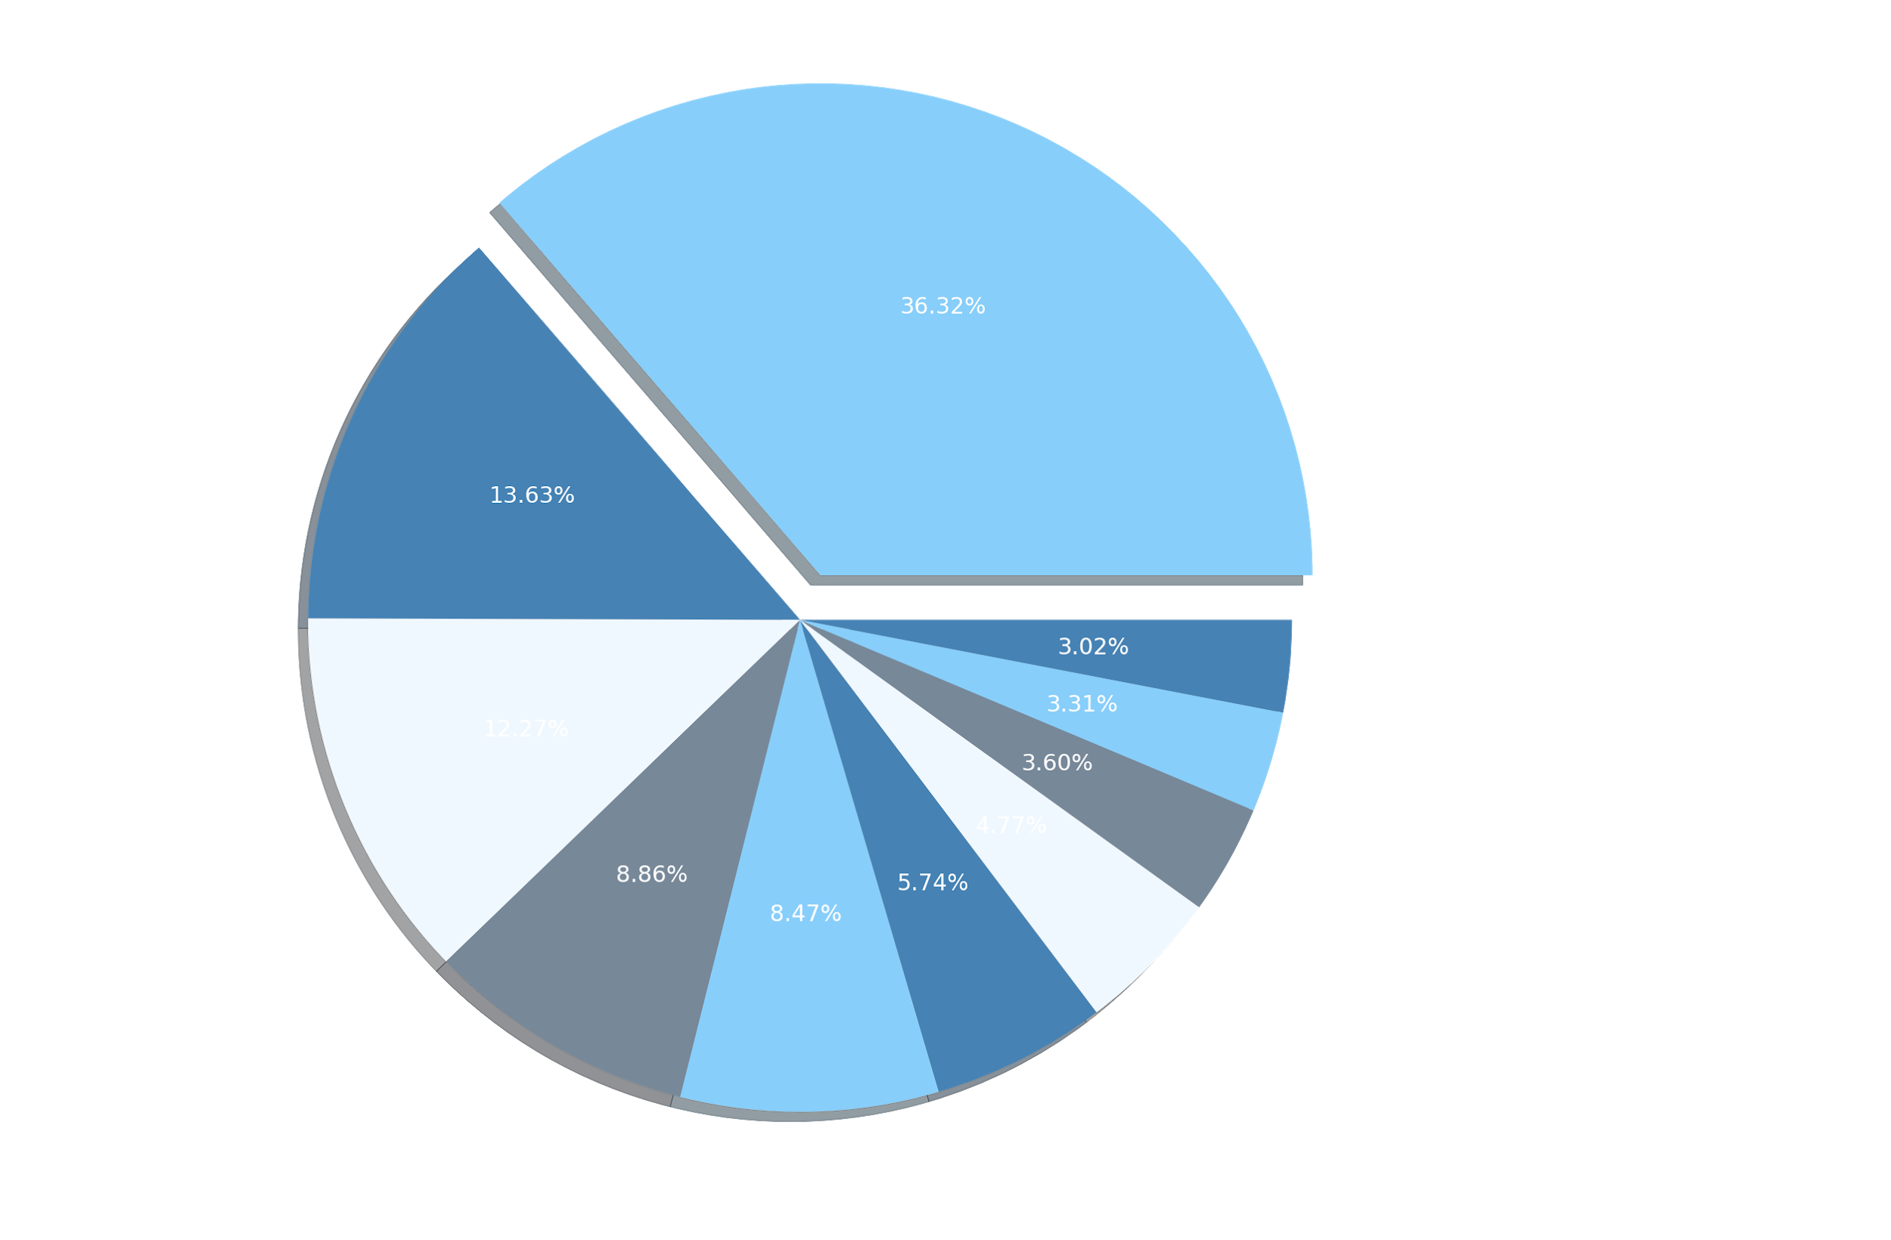
INDUSTRY
Top Ten Industries
Notes:
Frondia
-For industry analysis, we filtered our data set and narrowed it down to see what are the top ten industries that hire the most data related talents. As you can see from the pie chart, The IT industry is in the lead with around 36 percent, which is not surprising. It makes sense that if Hong Kong wants to develop more data scientists, the industry that will lead us into this path will be from the Technology sector. However, you can see that financial services and banking are now catching up on the IT industry with around 14 percent and 13 percent respectively, slowly switching their decision making from a traditional approach to more data and technical focused. Other industries like architecture and property management that were considered traditional are also shifting. Next, we are going to dive deeper and observe the correlation of years experience with career levels and job titles across the top five industries.

Slide 9
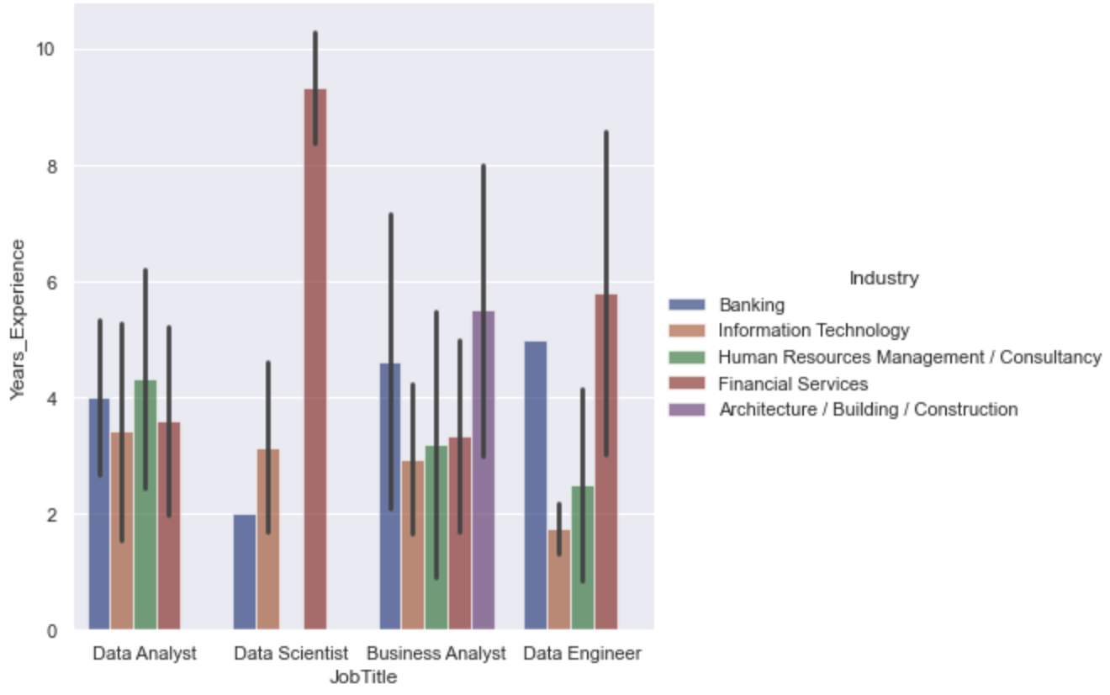
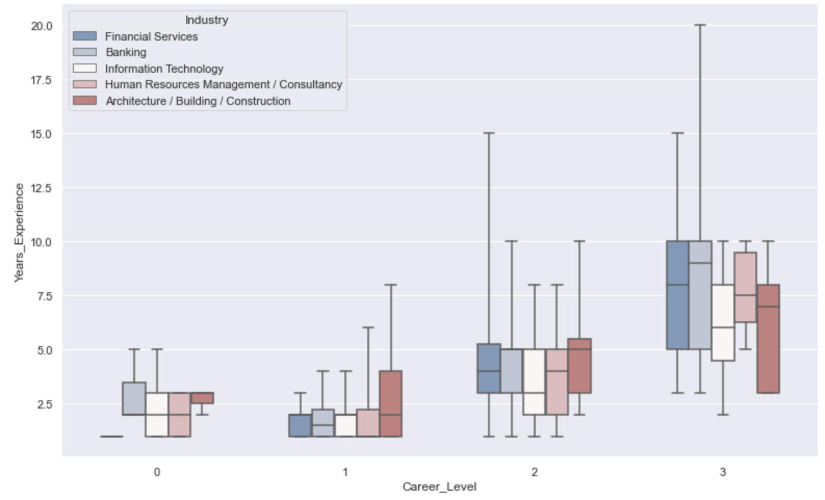
INDUSTRY
Average Years of Experience in Job Titles Across Industries
Average Years of Experience in Career levels Across Industries
Notes:
Frondia
On the left is the graph of average years of experience in career levels across top 5 industries. The 0 and 1,2,3 in career level stand for not specified, entry, middle, and senior level. Career level has a strong positive correlation to years of experience in general. However, the graph shows that banking and finance industries emphasize more on the years of experience when it comes to upgrading career level, so you might have to wait longer for your promotion before you hit certain years. Whereas, IT, Human resource, and architecture industries are more flexible in years of experience in workforce which means they could focus more on the employees’ talent and skill sets.
Moving on to the right graph is the average years of experience in job titles across industries. We narrowed down the data to the top four job titles that appear the most. Some industries do not appear on the graph because they are not hiring for the job titles that we web scrape. So from all the data that we have found, data analyst has the most consistent job hiring across industries, which requires around 3-4 years of experience. Data scientist has limited data and does not have consistency as you can see there is a high requirement for financial services but relatively little experience for banking and IT. Business analyst are somewhat consistent across industries with one year of variation except for architecture. The last is data engineer, which has large variations across industries. To wrap it up, we will very likely end up in the financial services industry if we want to become a data scientist from the start.

Slide 10
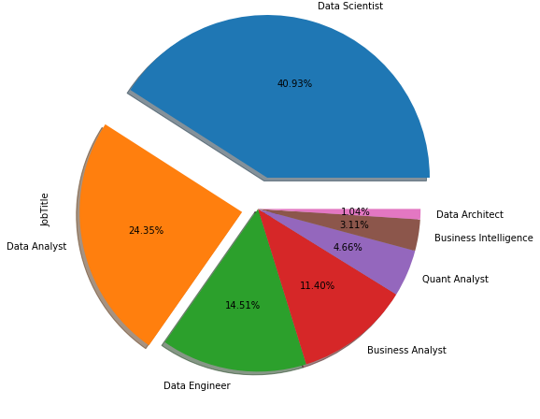
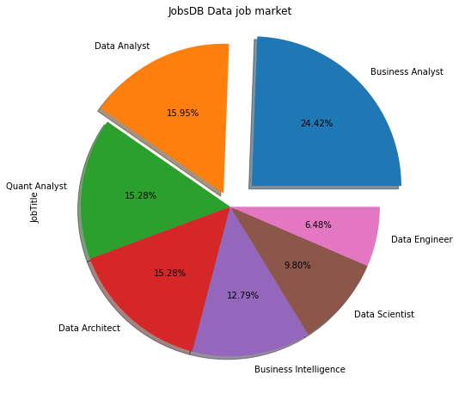
MARKET
b
Indeed Data Job market
JobsDB Data Job market
Notes:
Enghy
The two sources that we have used have different structures,
Indeed has nothing mentioned about the time line, therefore one source might already contain information from the other. I therefore looked into jobtitles for Indeed and JobsDB separately.
Biggest chunk for Indeed was Data Scientist 40, Data Analyst 24 and Data Engineer 14
Whereas for JobsDB, it was Business analyst 24, Data Analyst 15, Quant 15, Data Architect

Slide 11
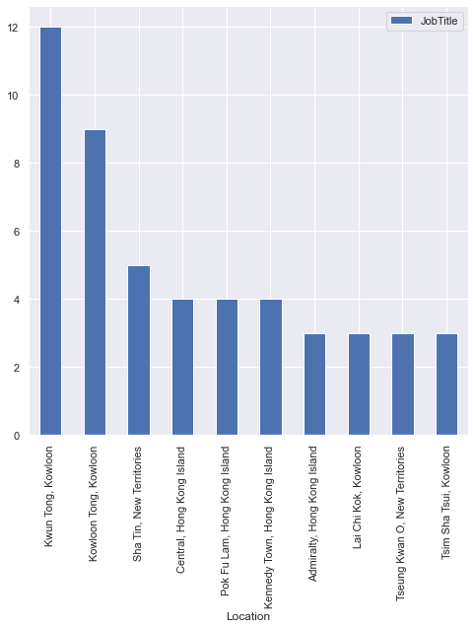
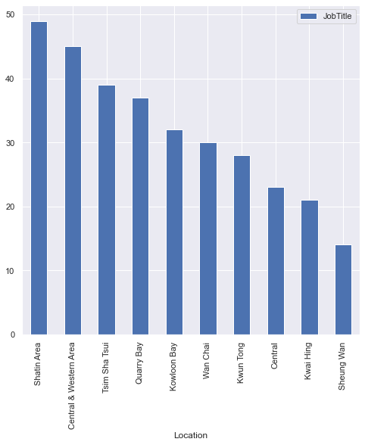
LOCATION
Indeed
JobsDB
Notes:
Enghy
We went to see where most of the DATA jobs were located.
According to Indeed, that would be Kwun Tong, Kowloon Tong and Sha Tin
Whereas according to JobsDB, that would be Central and the Western area, TST as well as Sha Tin

Slide 12
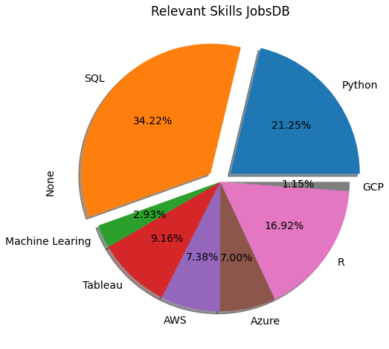
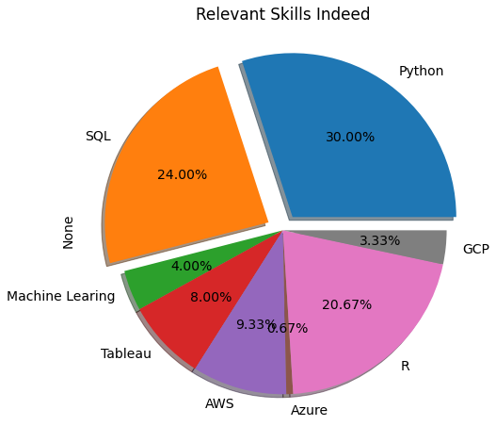

SKILLS
What We Found
Notes:
Enghy
JobsDB:
Top 3 are SQL, Python, R : totally they account for more than 70% of top 8 skill needed
Indeed :
The same, top 3 skills are also SQL, Python, R, accounts over 74% of top 8
And then depending on your specific job requirements or field, you can dig deeper into the other skills

Slide 13
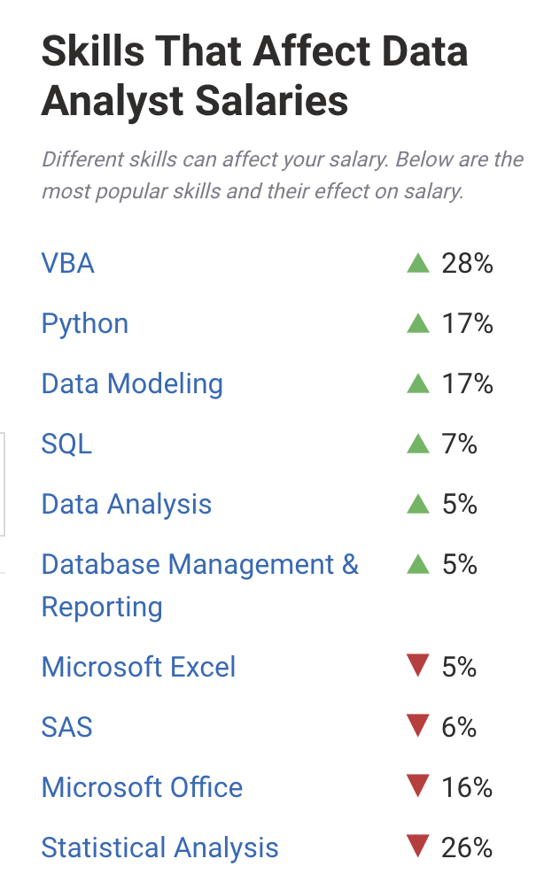

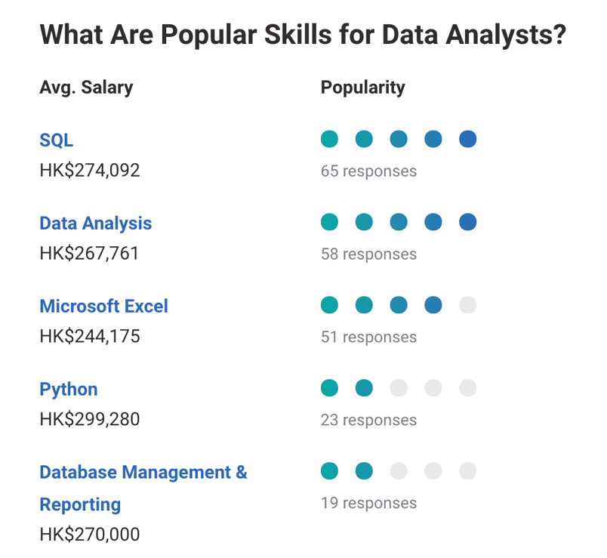
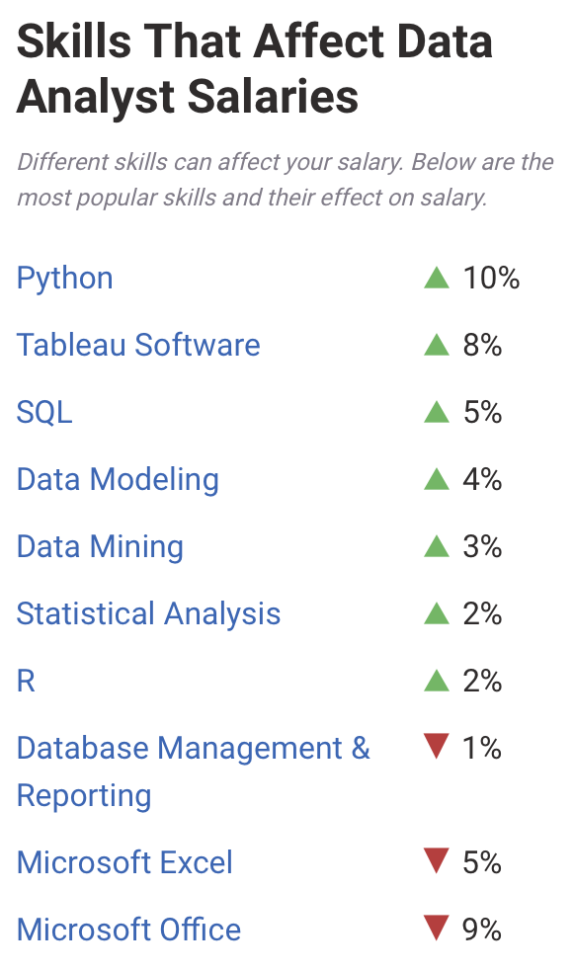
SKILLS
Online Research
US
HK
Retrieved from: https://www.payscale.com/research/HK/Job=Data_Analyst/Salary
Notes:
Enghy
Our findings regarding the skils for a DATA job is in line with our online research that you can see on this slide. You may have noticed that VBA is a skill still in demand, perhaps that is because many companies are using Excel...

Slide 14
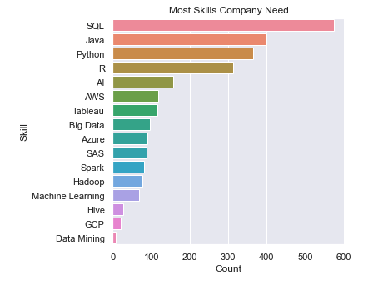

SKILLS
What We Found
Notes:
Enghy
In this slide, we were looking into what skills are in demand if we combined the information from the two source. Again, SQL, Python and R were most sought after skills.

Slide 15
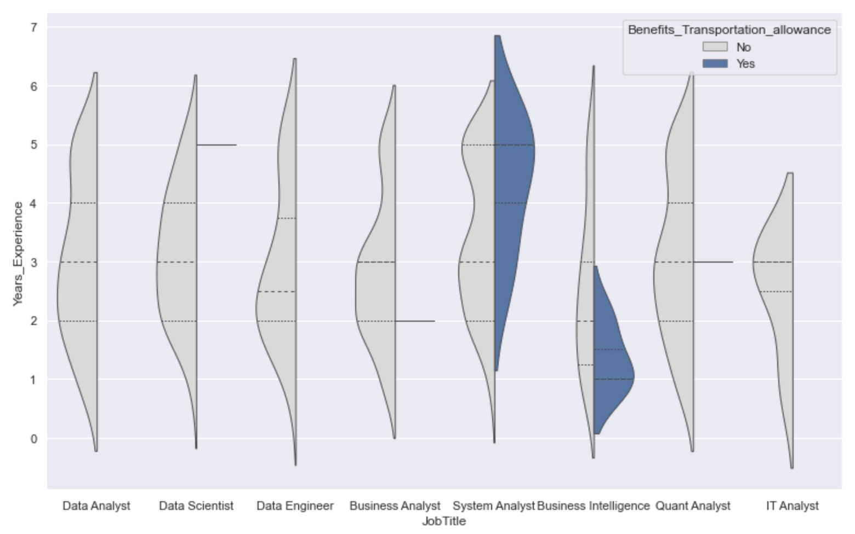

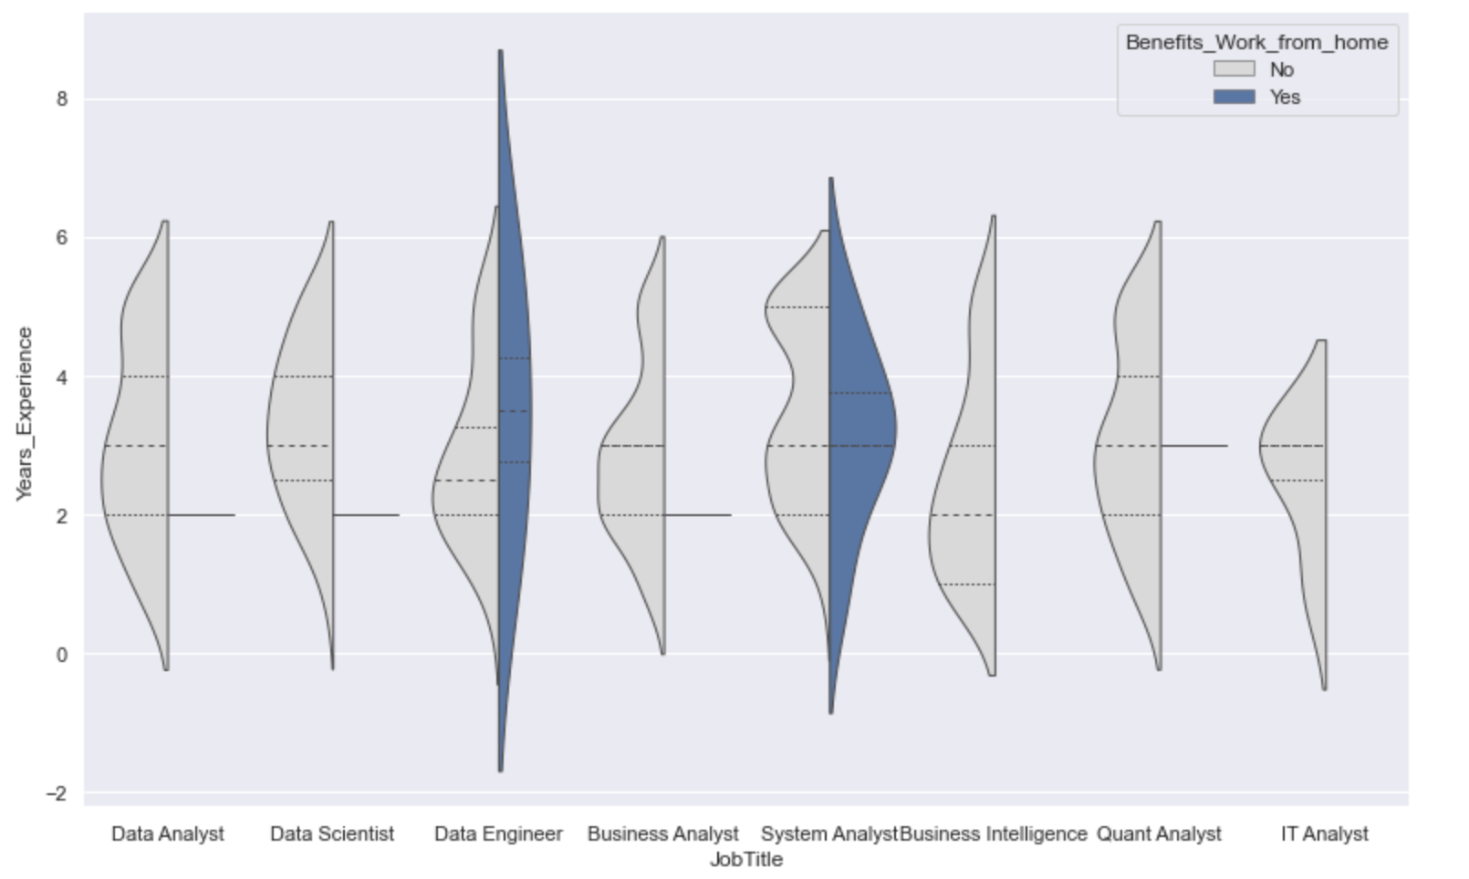
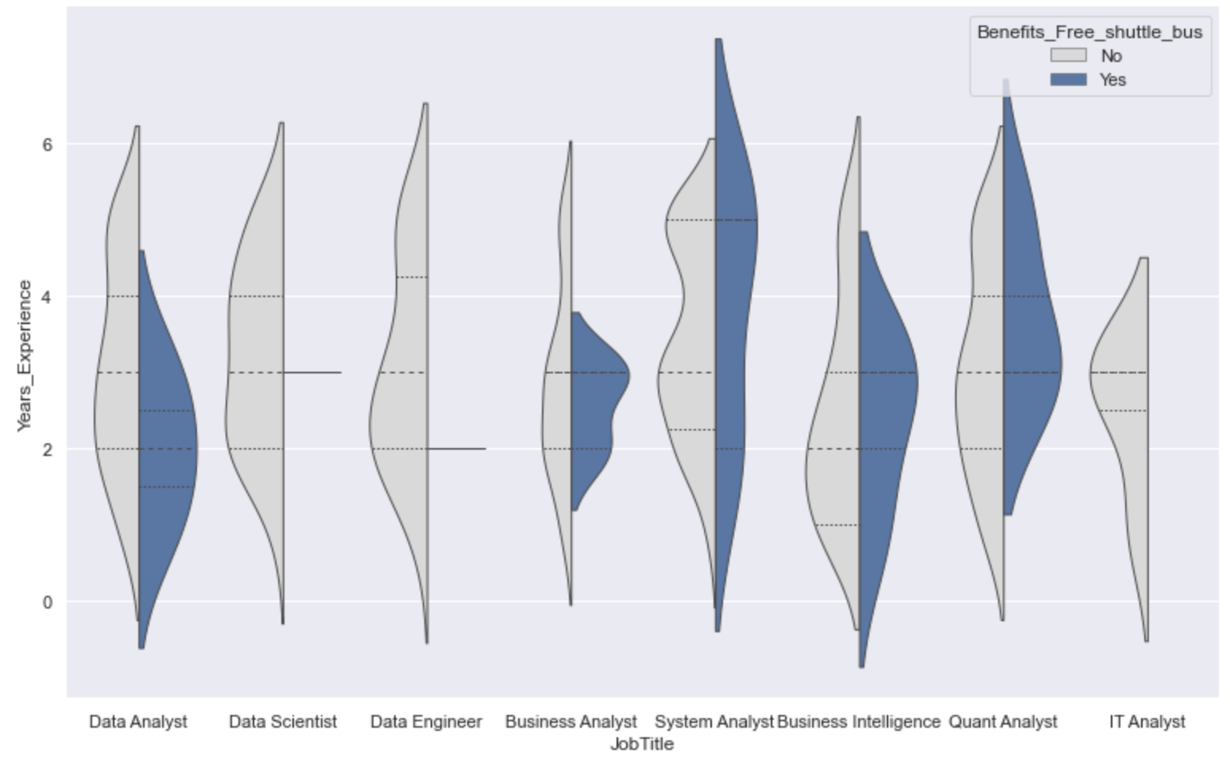

Notes:
## Jeff
Click this picture is filtered by Data Analyst Scientist, Engineer, Business Analyst, System Analyst, Business Intelligence, Quant Analyst, IT Analyst
Exp is Less than 5 years
Career Level set on Entry and Medium
In this year, the covid-19 pandemic ,many companies suggest employer Work from home.
But in IT industry, NOT everyone can.
If you Really love WFH, perhaps you should focus on Data Engineer or System Analyst
not feel sad on the company not allow work from home, i show u something .
Click Look at this graph, you can see only system analyst and business intelligence have transportation allowance
Click But a good news, more company provide FREE shuttle bus, Is it give you one more reason back to office?Click
Next i will pass to Enghy to talk about challenges

Slide 16
CHALLENGES AND NEXT STEPS
What challenges did we face?
what can we do better?
What can we do for future studies?
Notes:
1 min (Enghy)
-What challenges did we face?
-different data categories in two websites
-no specification in salary
-duplicate data from both sites( companies post to multiple sites)
-inconsistent patterns in job posts
-what can we do better?
-What direction can we go for future studies?
-try it on job websites in other APAC countries
- would be good if with techniques that we are going to learn in the coming weeks that we try to set a salary range for the each and every job title with respect to their skills or skill levels.

